Slide 1

Univariate Analysis
Sili Fan WCMC statistician

Slide 2
Study Objective
Generally :
1. Why univariate analysis?
2. What is hypothesis testing?
3. Descriptive statistics

Slide 3
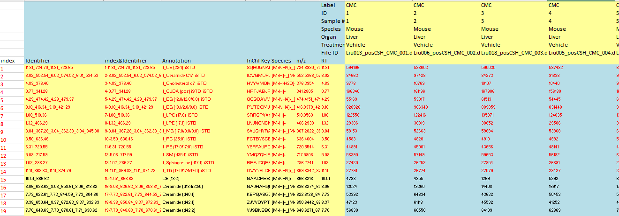
Why univariate analysis?
Univariate analysis means : analyzing metabolite one at a time (to test which one is associated with phenotype of interest).
…

Slide 4


Why univariate analysis?
Univariate analysis
Multivariate analysis (machine learning)
Multivariate analysis is harder to interpret
Multivariate is focused on prediction
Multivariate analysis requires much more samples than univariate analysis
metabolomics data: n<<p
Notes:
Prediction
What happens to a patient after 5 years.
Interpretation

Slide 5

Why univariate analysis?
With multivariate analysis:
0.5 * Color + 3 * Number of fingers + exp(hair style) + happiness^2
With univariate analysis:
Color
Size of eyes
Length of tail
Number of fingers
Hair style
Height
Existence of eyebrows
…
Univariate extracts relevant features (with the risk of false positive – we’ll see in the confounder session);
Multivariate can find a combination of features to make good classifications
Univariate analysis can find almost all the relevant features, thus often used as a pre-step of pathway enrichment analysis
We use p-value to determine if a feature is relevant or not.
Notes:
Why multivariate cannot select relevant feature.
Next talking about p-value

Slide 6
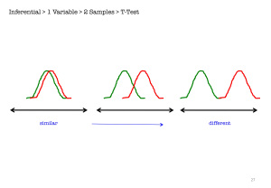
What is p value
With univariate analysis:
Color
Size of eyes
Length of tail
Number of fingers
Hair style
Height
Existence of eyebrows
…
We use p-value to determine if a feature is relevant or not.
Null hypothesis is an assumption about a population parameter. (e.g. average)
What is the level of certainty of assumption of the population? p-value
Sample
p = 0.1
Sample
p = 0.01
null
sample
p-value < 0.05: reject the null hypothesis

Slide 7
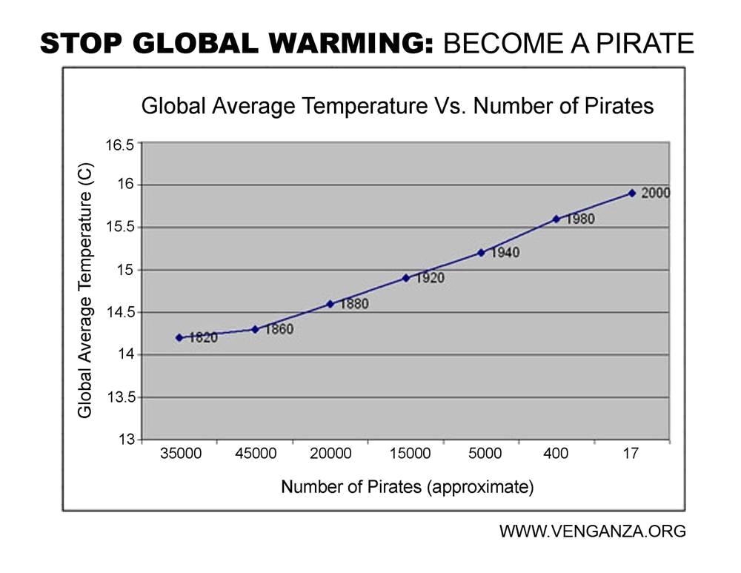
What is a p-value?
Be careful and critical
p-value ONLY helps you cast doubt on a null hypothesis.
Significance does not necessarily mean causations.
null hypothesis: N_{14°C} = N_{16°C}
But experimental study is better than observational study

Slide 8
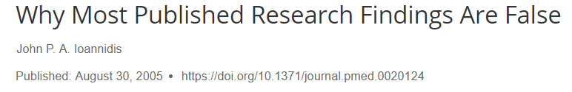
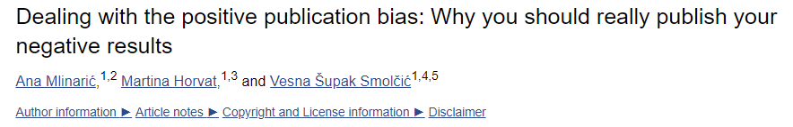
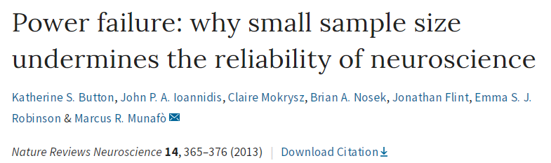
What is a p-value?
Be careful and critical
Suppose that a hypothesis that drug A has effect B has an a priori likelihood of 0.10 to be true.
If it is false, then the null hypothesis that drug A has no effect may be true, and the chance of a statistically significant result is 0.05.
If it is true, suppose the study has 80% power, so the chance of a statistically significant result is 0.80.
Out of 10,000 such hypotheses, 1000 are true. Of those 1000, 800 will have significant p-values.
Out of the 9,000 hypotheses that are not true, 450 will have significant p-values.
So the chance that the result is true given that p < 0.05 is 800/1250 = 64%
See also:

Slide 9

What is a p-value?
Be careful and critical
If there are 20 research groups pursuing this hypothesis, and if the result is published if any of the groups gets a significant p-value, then all 1000 of the true hypotheses will be verified, but also 5,774 of the 9,000 false hypotheses will be “proven”
The chance that a published result is true would then be 1000/6774 = 15%.
This gets worse if 1) there are more groups, 2) the finding is more surprising, 3) the power is lower (⬄ sample size is small).
For example, with 50 groups, and a priori probability of 1%, and 30% power, the chance that the result is true is 1%.
Plus publication bias …
See also:

Slide 10
null hypothesis tests
and types of study design
Study design
Hypothesis tests
Two independent groups
Multiple independent groups
Two paired groups
Multiple paired groups
cross two way independent groups
cross two way paired groups
cross two way mixed groups
…
t test
ANOVA
Paired t test
Repeated ANOVA
Two way ANOVA
Two way repeated ANOVA
Two way mixed ANOVA
…
select the appropriate test
…
Notes:
What is independent group?
What is paired group?

Slide 11

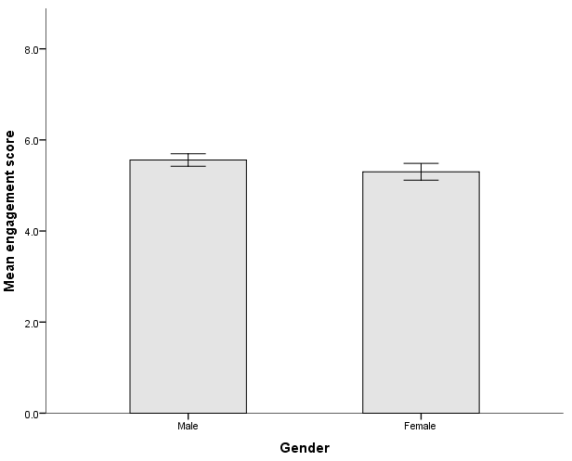
t test
two independent groups
subjects are different between two groups
For example, determine whether (mean) salaries, measured in US dollars, differed between males and females
salary
Welch t test
Mann-Whitney U test

Slide 12
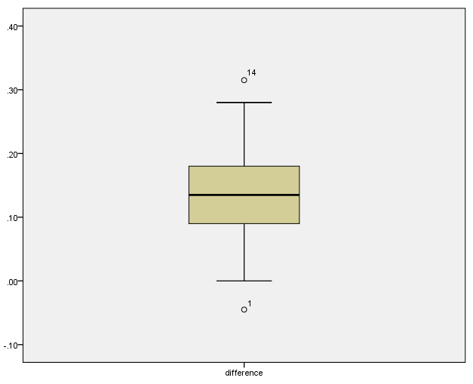
paired t test
two paired groups
subjects are same between two groups
Time
For example, understand whether there was a mean difference in daily calorie consumption before and after a six week of exercise program.
paired t test
Wilcoxon signed-rank test

Slide 13
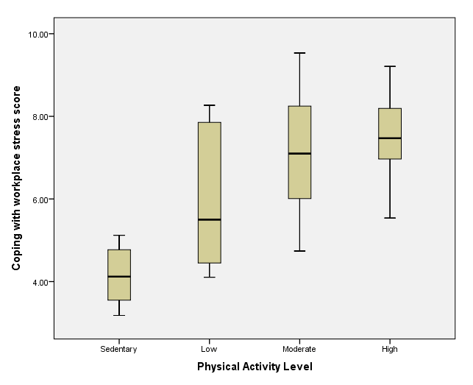
ANOVA
multiple independent groups
subjects are different among groups
For example, to determine whether exam performance differed based on test anxiety levels amongst students
Welch ANOVA
Kruskal-Wallis H test
Exam score
Games-Howell test
Mann Whitney U test
with Holm–Bonferroni correction
Post Hoc Analysis
Anxiety levels

Slide 14
repeated ANOVA
multiple paired groups
subjects are same among groups
Time
For example, understand whether there was a mean difference in daily calorie consumption before and after a three weeks and six weeks of exercise program.
repeated ANOVA
with Greenhouse-Geisser correction
Friedman test
paired t test
With Holm–Bonferroni correction
Post Hoc Analysis
Wilcoxon signed-rank test
with Holm–Bonferroni correction

Slide 15
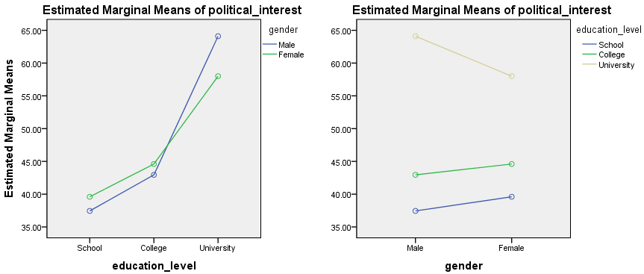
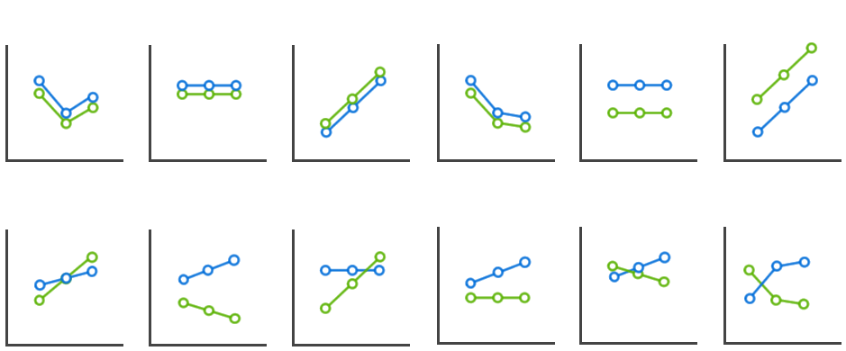
Two-way ANOVA
independent * independent
subjects are different among groups
two-way ANOVA
bootstrap approaches
Not Significant
Main effect
Significant
Simple main effect

Slide 16
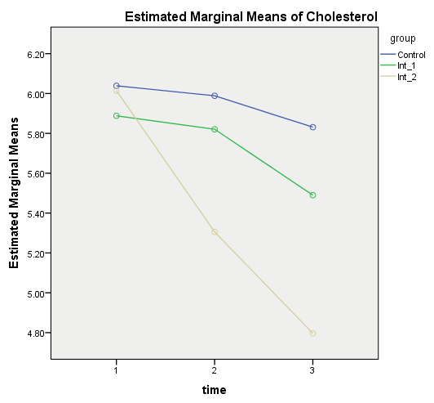
Two-way mixed ANOVA
independent * paired
subjects are same among groups
two-way mixed ANOVA
bootstrap approaches
Not Significant
Main effect
Significant
Simple main effect

Slide 17
Non parametric test or parametric test?
Parametric
Non Parametric
Assumptions
Normality (Shapiro test)
Equal variance (Levene Test)
Sphericity (Mauchly Test)
4. Equal covariance (Box Test) …
Robust with assumptions when sample size is large and equal among groups
powerful when assumptions are met
Sensitive to outliers
Assumption free
Less affected by outliers
Powerful even when assumptions violated

Slide 18
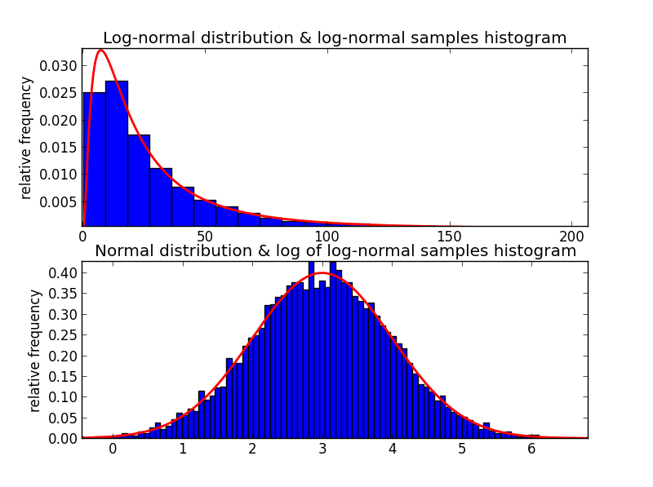
Non parametric test or parametric test?
Normality
log normal
normal
When normality is violated, nonparametric is more powerful.
When normality holds, parametric is a little bit more powerful.

Slide 19
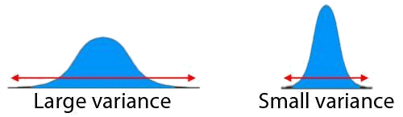
Non parametric test or parametric test?
Equal variance
If variance is different, use welch t test (ANOVA) or nonparametric tests.
When sample size is large enough, the assumption of equaled variances becomes negligible.

Slide 20
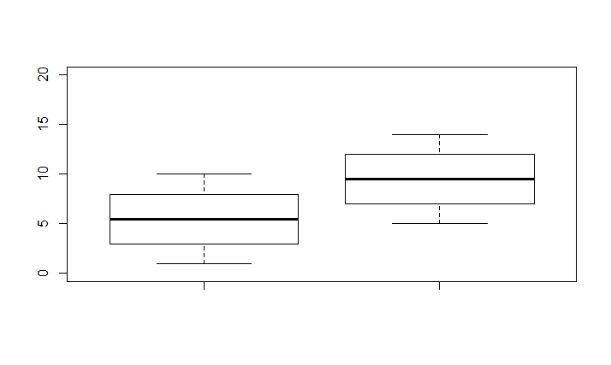

Non parametric test or parametric test?
outlier
p = 0.008
para
→ 0.091
nonpara
p = 0.012
→ 0.022
Non parametric test is more robust than parametric test

Slide 21

Personal statements
Non parametric test or parametric test?
When sample size is not extremely small, I prefer nonparametric test because it is robust with outlier.
Perform both non parametric and parametric test and consider features when non parametric and parametric have controversy result.
Sili Fan, September 2016

Slide 22
multiple comparison problem
…

Slide 23
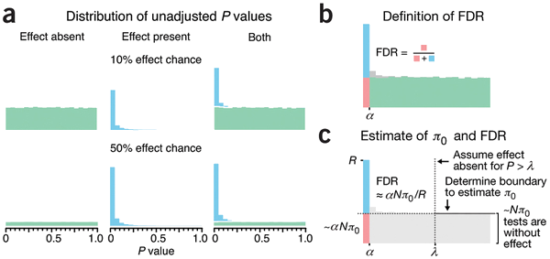

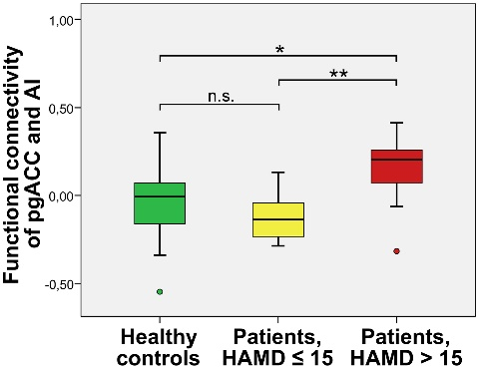

multiple comparison problem
1. FDR Correction
corrects False Discovery Rate
Remove raw large p values
Target validation
Permutation test
Use FDR correction
among features (vertically)
2. Bonferroni Correction
corrects Familywise Error Rate
Use Bonferroni
within features (horizontally)
(post hoc analysis)
$α$: error rate

Slide 24
How do we describe the data?
Descriptive statistics
Centrality
Mean, Median, Mode
Variability
Variance, standard deviation and standard error, IQR
Relative standing
Relative standard deviation

Slide 25
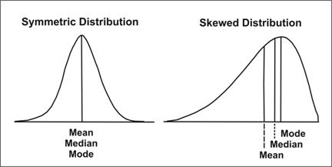
How do we describe the data?
Mean, Median, Mode
mean: the average value.
median: the “middlemost” value.
mode: the most common value
centrality
outlier sensitivity: mean > median > mode
Most parametric tests use mean, while non-parametric test use median to compare centrality between populations
Example: fold change (centrality of A/ centrality of B)

Slide 26
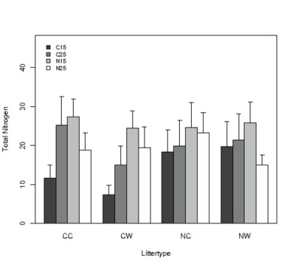
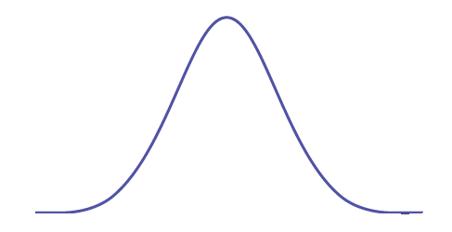
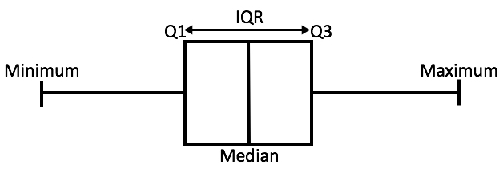
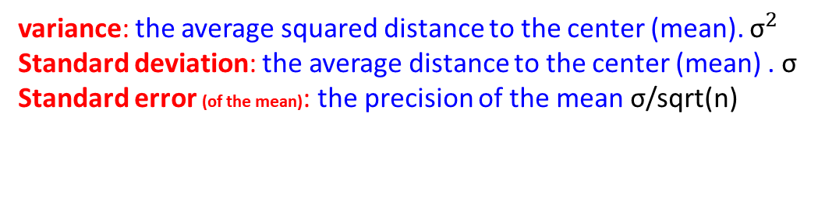
How do we describe the data?
Variance, SD, SE, IQR
SD or SE??
variance: the average squared distance to the center (mean). ${\text{σ}}^{2}$
Standard deviation: the average distance to the center (mean) . $\text{σ}$
Standard error (of the mean): the precision of the mean $\text{σ}$/sqrt(n)
variability
Interquartile range (IQR): very often used to define outlier in a boxplot. Non-parametric

Slide 27

How do we describe the data?
RSD (a.k.a coefficient of variation)
Relative standard deviation: is the standard deviation relative to the mean
unit free
Suitable with data sets with widely different means (i.g. metabolomics data)
The RSD of quality controls are often used as an indication of the quality of samples.
Relative standing

Slide 28
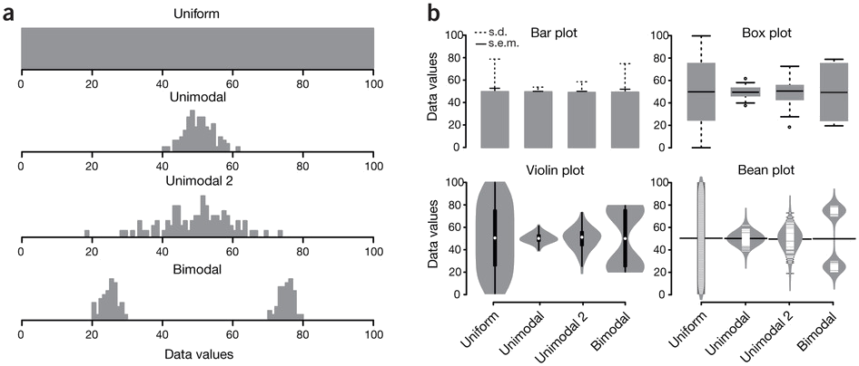
Visualization
b) 4 plots visualizing 100 samples of each distribution
a) 4 statistical distributions.
Bar plot shows the mean, s.d. and s.e.m.
Violin plot and bean plot represent the distribution.
Box plot shows five-number summary (min, low quantile, median, high quantile and maximum) and outlier; recommended

Slide 29
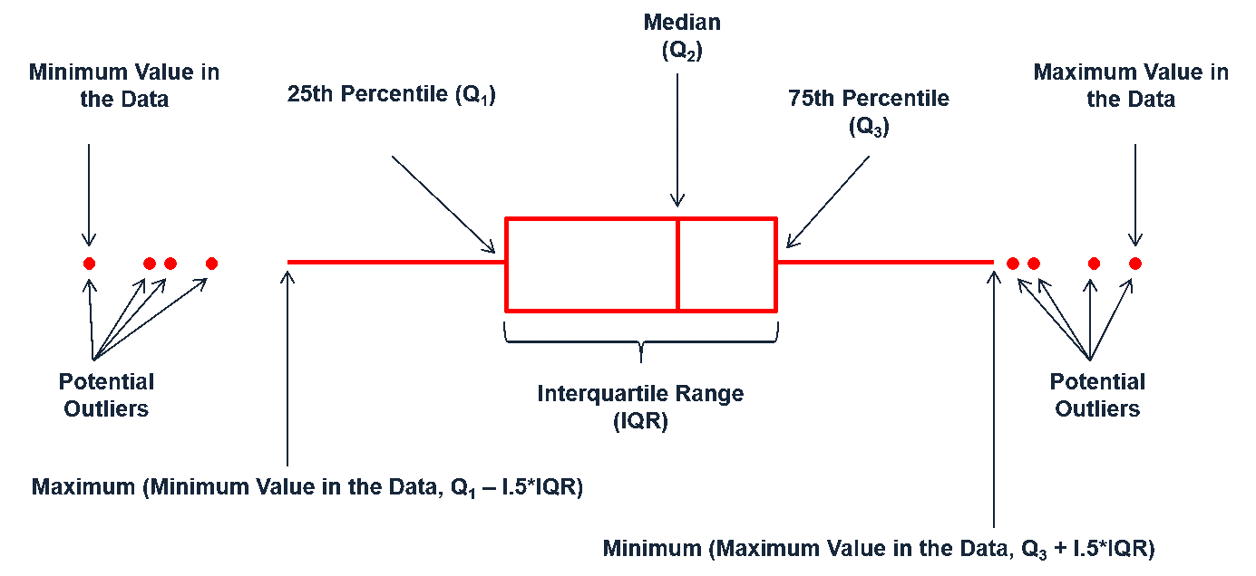
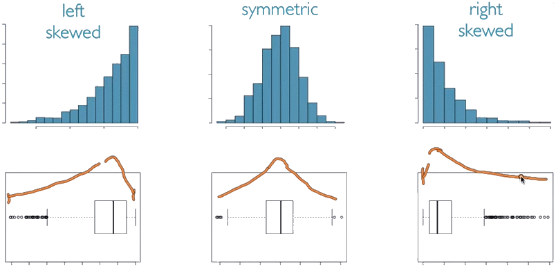
Visualization
boxplot
What is distribution type of the red box plot?

Slide 30
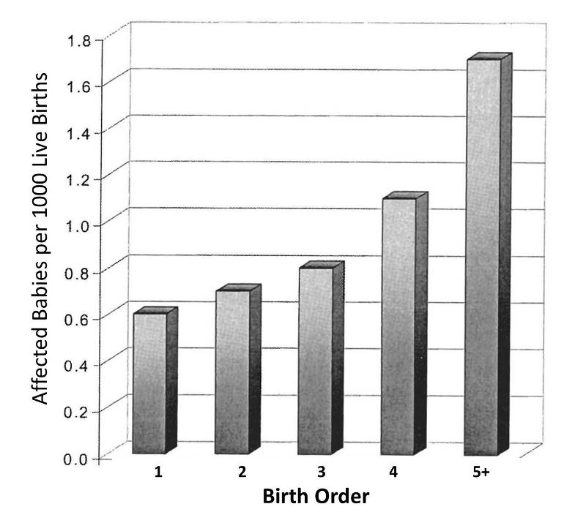
Confounder
Investigated the association between birth order and the risk of Down Syndrome.
the order in which a women's children are born is also linked to her age at the time of her child's birth
Risk of Down Syndrom ~ birth order + age

Slide 31
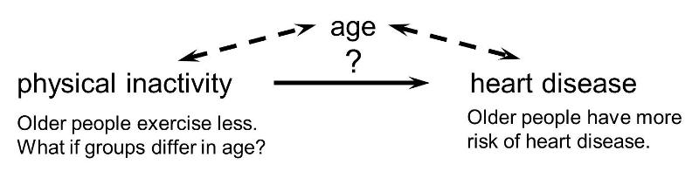
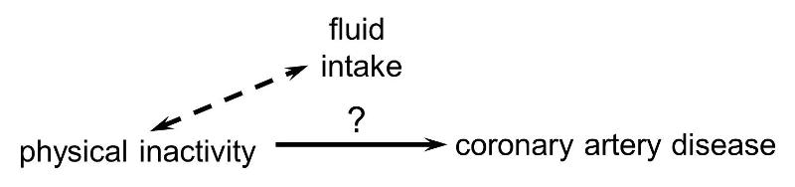
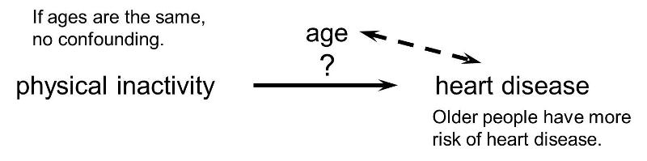
Confounder
ascertain the strength of association between physical inactivity and heart disease

Slide 32
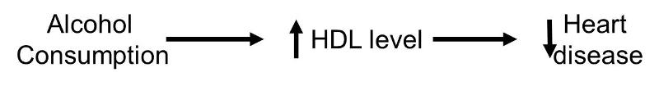
Confounder
- definition
The confounding factor must be associated with both the risk factor of interest and the outcome.
The confounding factor must be distributed unequally among the groups being compared.
A confounder cannot be an intermediary step in the causal pathway from the exposure of interest to the outcome of interest.

Slide 33
Confounder
- check
Men who worked in asbestos mines were exposed to asbestos, which is a known risk for lung cancer.
Smoking is a risk factor for lung cancer
Miners tend to smoke more cigarettes because of the stress miners are exposed to, especially when they work underground.
Could asbestos mining be a confounder of the relationship between cigarette smoking and lung cancer?

Slide 34
Confounder
- How to deal with confounder
Restriction (gender, etc)
Matching (aging, etc)
Randomization in Clinical trials
Multiple linear regression
Outcome ~ metabolite + confounder1 + confounder2 + …
Multivariate Analysis
Use: Outcome - confounder1 - confounder2 - …

Slide 35
p-value estimate the certainty of a assumption of a population.
p-value cannot tell you causation.
Selected a hypothesis procedure corresponding to study.
Determine parametric or non-parametric.
For two-factor study design, we should focus on interaction term first.
It is always a good practice to visualize the data before AND after analysis.
Conclusion remarks

